Slide 1
Playing the Long Game of Mental Divorce
By David Lee Burris

Slide 3
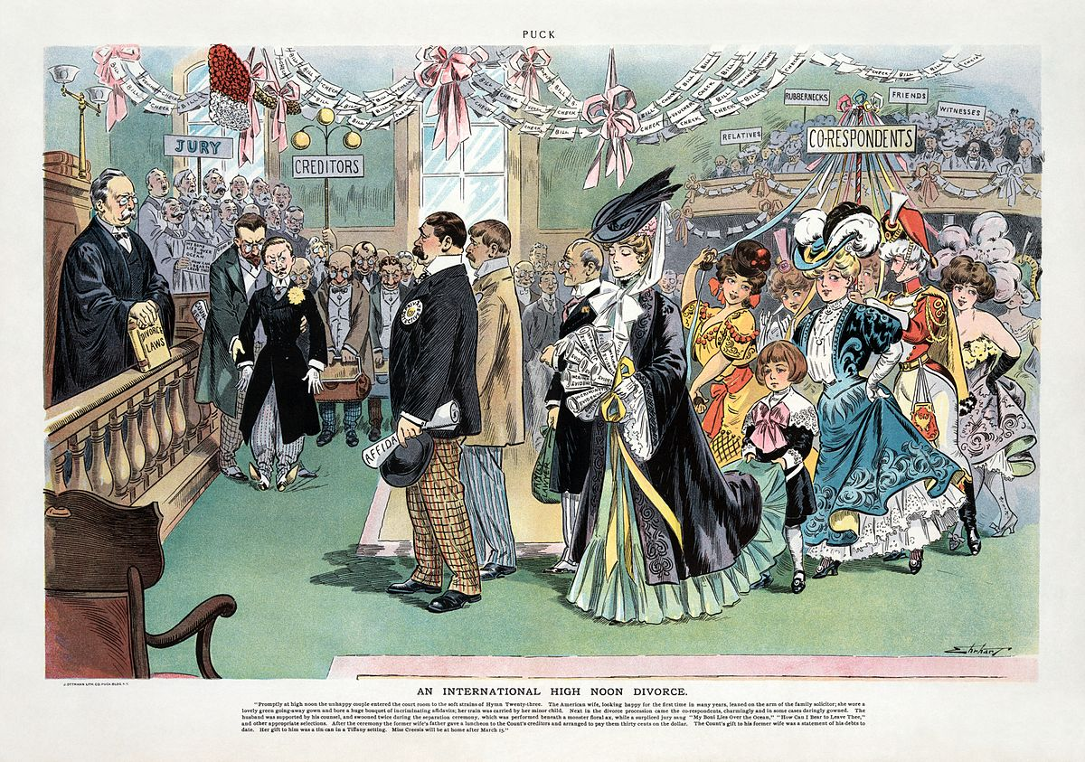

Slide 4
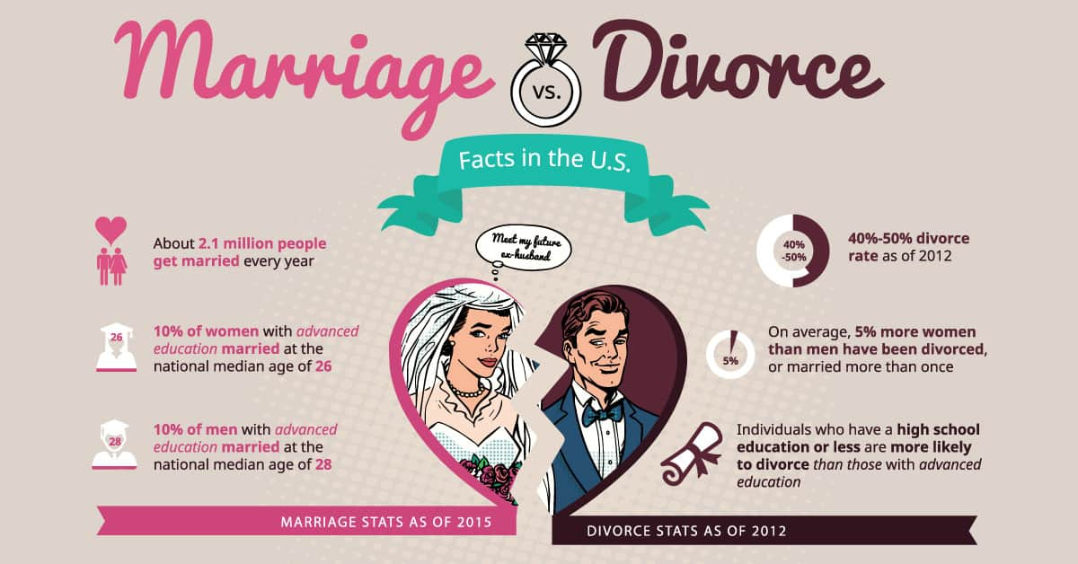

Slide 5
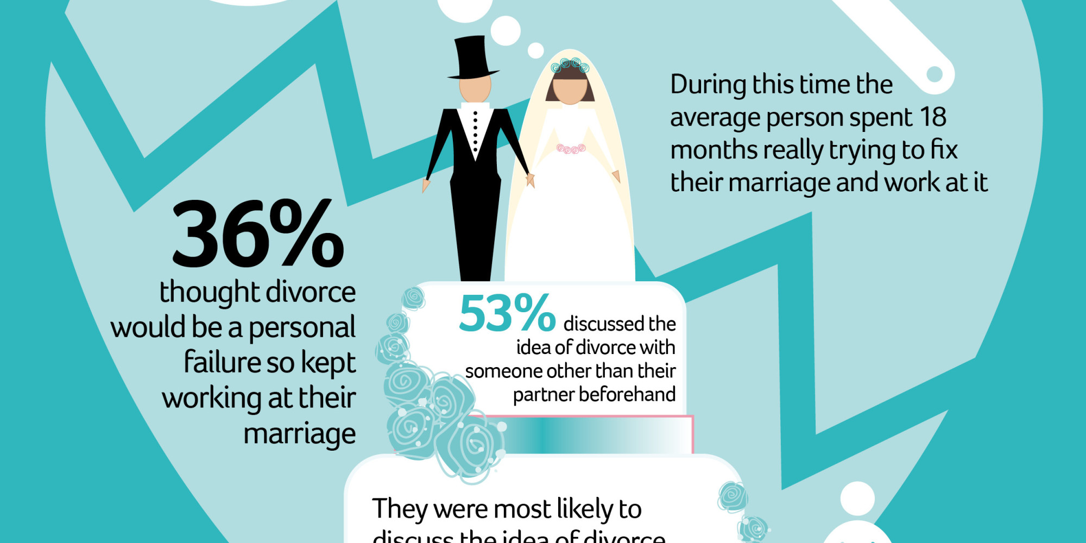

Slide 6
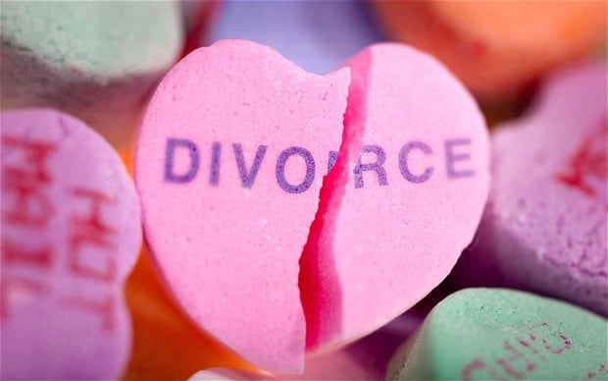

Slide 7
The Headgames Of Mental Divorce
divorce: old testament vrs. new
Early Christian comment on mdr
distinguishing married vrs. Bound
mdr protracted process endgaming

Slide 8
The Headgames Of Mental Divorce
divorce: old testament vrs. new
Early Christian comment on mdr
distinguishing married vrs. Bound
mdr protracted process end-gaming

Slide 9
MDR: old testament vs. new testament

Slide 10
Is the Teaching of Jesus on Marriage, Divorce, and Remarriage a Part of Old Testament Legislation?
2
Moses & Christ Compared
What constitutes adultery?
Jesus extends the definition of adultery beyond its Old Testament sense to include remarriage after unscriptural divorce and remarriage (Matt. 5:32; 19:9; Mark 10:11-12; Luke16:18)
“Adultery” defined as sex between parties married to someone else (Lev. 20:10; 18:20; Prov. 6:26-29, 32-34; Jer. 29:23)
Not post-divorce remarriage (Deut. 24:2)

Slide 11
Is the Teaching of Jesus on Marriage, Divorce, and Remarriage a Part of Old Testament Legislation?
2
Moses & Christ Compared
What is a lawful cause for divorce?
A finding of “some uncleanness” (KJV, NKJV), “unseemly thing” (ASV), or “some indecency” (NASB, ESV)
Heb. ’ervah debar lit. “[a] nakedness thing” —some indecent, immodest behavior short of adultery (Deut. 22:13-14; 20-21, 22)
“Fornication” is the sole cause for divorce (Matt. 5:32; 19:9).

Slide 12
Is the Teaching of Jesus on Marriage, Divorce, and Remarriage a Part of Old Testament Legislation?
2
Moses & Christ Compared
Laws of Reconciliation
“An abomination before the LORD” for a put away woman who had remarried to return to the husband who first put her away (Deut. 24:3-4)
Reconciliation is encouraged without qualification or prohibition (1 Cor. 7:11)

Slide 13
Is the Teaching of Jesus on Marriage, Divorce, and Remarriage a Part of Old Testament Legislation?
2
Moses & Christ Compared
Certification
A woman had to be provided with a “certificate of divorce” (Deut. 24:1)
To give a woman a certificate of divorce essentially sanctioned her right to remarry.
This provision is not commanded or restated.
Emphasis is the binding nature of marriage (Rom. 7:2a; 1 Cor. 7:39a).

Slide 14
Is the Teaching of Jesus on Marriage, Divorce, and Remarriage a Part of Old Testament Legislation?
2
Moses & Christ Compared
Priests and Divorced Women
Only priests and High Priests were forbidden from marrying a divorced woman (Lev. 21:7, 14)
All who marry a woman divorced (when she did not divorce her husband because of his fornication) commit adultery (Matt. 5:32; 19:9; Mark 10:11-12; Luke16:18)

Slide 15
Is the Teaching of Jesus on Marriage, Divorce, and Remarriage a Part of Old Testament Legislation?
2
Moses & Christ Compared
The Marriage of Priests
This is not restated for the “holy priesthood” of believers under Christ (cf. 1 Pet. 2:4-9; Rev. 1:6).
Priests and High Priests could only marry virgins (Lev. 21:7, 14)

Slide 16
Is the Teaching of Jesus on Marriage, Divorce, and Remarriage a Part of Old Testament Legislation?
2
Moses & Christ Compared
Polygamy
Jesus restates the original intention for marriage as “two” becoming “one flesh” (Matt. 19:5; Mark 10:8; Gen. 2:24).
Allowance (and protection) was mandated for a man to have more than one wife (Exod. 21:10-11; Deut. 21:15-17; 25:5-10).

Slide 17
Is the Teaching of Jesus on Marriage, Divorce, and Remarriage a Part of Old Testament Legislation?
2
Moses & Christ Compared
Levirate Marriage
Not restated—and in the event that a brother is already married would be precluded by the “two shall become one flesh” definition of marriage asserted by Jesus (Matt. 19:5; Mark 10:8; Gen. 2:24).
A brother was expected to take the childless wife of his deceased brother to raise up children, or follow a procedure to release her (Deut. 25:5-10).

Slide 18
Is the Teaching of Jesus on Marriage, Divorce, and Remarriage a Part of Old Testament Legislation?
2
Moses & Christ Compared
Divorce and false accusation
One who made a false accusation of premarital fornication could never divorce his wife (Deut. 22:19)
This is not restated under Christ.

Slide 19
Is the Teaching of Jesus on Marriage, Divorce, and Remarriage a Part of Old Testament Legislation?
2
Moses & Christ Compared
Eunuchs
Eunuchs physically or “for the kingdom of heaven”) are no longer excluded (cf. Isa. 56:3-5; Acts 8:26-39)
A eunuch could not offer sacrifices or enter the assembly of the Lord (Lev. 21:17-23; Deut. 23:1).

Slide 20
Is the Teaching of Jesus on Marriage, Divorce, and Remarriage a Part of Old Testament Legislation?
4
Answers
D. Force of 1 Corinthians 7
1 Corinthians 7 is irreconcilable with Mosaic Law
Unqualified encouragement to post-divorce reconciliation (1 Cor. 7:11; cf. Deut. 24:1-4).
Marriage to unbeliever (1 Cor. 7:12-15; cf. Deut. 7:3-4).
A life-long bond to a husband (1 Cor. 7:39; cf. Deut. 24:1-4; Rom. 7:1-3).
These are not the same law!

Slide 21
Is the Teaching of Jesus on Marriage, Divorce, and Remarriage a Part of Old Testament Legislation?
4
Answers
D. Force of 1 Corinthians 7
Fuller explanation of Jesus’s teaching while on earth and inspired revelation of the Law of Christ on MDR
“Not I, but the Lord” section (1 Cor. 7:10-11)—ramifications of teaching in Gospels for the married.
“I, not the Lord” section (1 Cor. 7:12-40)—issues not addressed by Jesus while on earth—marriage to unbelievers (7:12-24), marriage during times of “distress” (7:25-38), and widows (7:39-40).

Slide 22
Is the Teaching of Jesus on Marriage, Divorce, and Remarriage a Part of Old Testament Legislation?
4
Answers
D. Force of 1 Corinthians 7
“Let each one remain in the calling in which he was called” (7:20)
The one married to an unbeliever, “let him not divorce her” (7:12)—“let her not divorce him” (7:13)
Compares conditions unfavorable but not sinful—circumcised or uncircumcised (7:18-19) slave or free (7:21-23)—not unlawful marriages

Slide 23
What About The “R” Word – Repentance?
“David” & the Attempt To Broaden Grace
“Will not the same God of loving kindness and tender mercies forgive and blot out sins under a system of grace as He did under a system of law?”
(Hailey, 73).
There was grace available under the Old Covenant and there is a law aspect in the New Covenant of grace (Gen. 6:8; Psa. 51; I Cor. 9:21; Gal. 6:2; James 1:25).
Grace does not permit a sinful way of life, but leads us to be a new creation (Titus 2:11-15; Jude 4).

Slide 24
MDR: early christians

Slide 25
Justin Martyr (circa 150 AD)
It is then, far more reasonable to see Justin as condemning (1) lusting after a married woman and (2) marrying her subsequent to her being freed by divorce. Such a man should rather remain single than fulfill his lustful desires, and such a man should understand that whether he accomplishes his goal or only thinks about it, he is guilty of the same sin of adultery before God. Roman law might not hold a man guilty of offense for lusting after his neighbor’s wife or for marrying her were she to manage to free herself from her husband, but the Bible does. But Justin does not condemn the remarriage of a disciplining [sinned-against] spouse (nor does he in the Second Apology), nor does he condemn the remarriage of an innocently divorced spouse. His condemnations are always in the context of a woman’s legitimate marriage; that marriage should not be broken up in thought or by action by the man to whom Justin refers (and condemns).

Slide 26
Theophilus of Antioch (circa A.D. 180)
The relevant chapter in Theophilus’ work is entirely in the context of coveting another man’s wife. It begins with a reference to lustful looks at another’s wife, moves thru a quote of Proverbs 4:25 (condemning lustful looks), through a quote of Matthew 5:28, to the inverted quote of Matthew 5:32, and ends with a quote from Proverbs (6:27-29) that once more condemns taking another man’s wife. What seems obvious is that Theophilus is condemning remarriage when it is to a woman who has been wrongfully taken from another man. The lustful look takes heart in the fact that the object of desire has been freed by divorce (probably instigated by the woman and the coveting man). Theophilus condemns such “legal adultery.” And he condemns the man who unjustly divorces his wife as well!

Slide 27
Origen (circa 185-254)
[Origen] speaks of Christ as divorcing Israel and (re)marrying the Church, a clear case of disciplinary divorce followed by remarriage. And, in those passages, Origen insists that Christ, in doing so, did not break the commandment not to sunder the “one-flesh” union, because he had the grounds of “fornication,” grounds that Origen identifies as “reasonable” for the “dissolution of marriage.” We have in Origen, then, a Father who did not believe in the indissolubility of marriage, who did believe that one could and should divorce (not merely “separate”) if one had the grounds of fornication, and who believed that one who divorced as a discipline could morally remarry.

Slide 28
VARIOUS ARGUMENTS AGAINST SECOND MARRIAGE
We have been taught by the Lord and God of salvation that continence is a means of attaining eternal life, a proof of the faith that is in us, a pledge of the glory of that body which will be ours when we put on the garb of immortality, and, finally, an obligation imposed upon us by the will of God.⁶² Regarding this last statement, I suggest that you reflect seriously on the following: if it is a fact that not a leaf falls to the ground unless God wills it, then it is equally true that no man departs this life unless God wills it. For it is necessary that He who brought us into the world should also usher us forth from it. Therefore, when God wills that a woman lose her husband in death, He also wills that she should be done with marriage itself. Why attempt to restore what God has put asunder? Why spurn the liberty which is offered you by enslaving yourself once more in the bonds of matrimony? Art thou bound in marriage? Scripture says, seek not to he loosed. Art thou loosed from marriage? seek not to be bound. For, though you sin not in remarrying, yet, according to Scripture, tribulation of the flesh will follow if you do.
Hence, as far as such a sentiment is possible, let us be grateful for the opportunity offered us of practicing continence and let us embrace it immediately, once it is offered. Thus, what we were unable to do in marriage we will be able to do in bereavement. We ought to make the most of a situation which removes what necessity imposed.
The law of the Church and the precept of the Apostle show clearly how prejudicial second marriages are to the faith and how great an obstacle to holiness. For men who have been married twice are not allowed to preside in the Church nor is it permissible that a widow be chosen unless she was the wife of but one man. The altar of God must be an altar of manifest purity⁶⁷ and all the glory which surrounds the Church is the glory of sanctity.
Tertullian. (1951). Tertullian: Treatises on Marriage and Remarriage: To His Wife, An Exhortation to Chastity, Monogamy. (J. Quasten & J. C. Plumpe, Eds., W. P. Le Saint, Trans.) (Vol. 13, pp. iii–111). New York; Mahwah, NJ: The Newman Press.

Slide 29
MARRIAGE IN THE LORD
I have just finished describing, as well as I could, my dearest companion in the service of the Lord, the manner of life a Christian woman should embrace when, for one reason or another, her marriage is brought to an end. Now, recognizing the fact of human frailty, let us turn our attention to an alternative course of action. We are led to do this because of the conduct of certain women who, when given an opportunity of practicing continence by reason of a divorce or the death of a husband, not only rejected the opportunity of living so good a life, but, in contracting a second marriage, were not even mindful of the prescription that they should above all marry in the Lord. As I write these words I am disturbed at the thought that I, who but recently exhorted you to practice monogamy and remain a widow, may be responsible, by my mere mention of marriage, for making you disposed to give up the higher ideal. Still, if you are truly wise, you will see clearly that you ought to lead the kind of life which is the best for you. It is because this ideal is so lofty, so difficult, and so exacting that I have tempered, to some extent, my remarks on the subject. I would have had no reason at all to bring up the matter, were it not for a very serious consideration which has engaged my attention. The continence which makes possible a life of widowhood is something heroic, and therefore it would seem that a woman can be all the more easily pardoned if she does not persevere in such a state. Failure is easy to excuse wherever success is difficult to achieve. But to marry in the Lord is well within our power, and so failure here means that our guilt is the greater for our having neglected a duty which we are able to fulfill. There is also this added consideration: when the Apostle writes that widows and virgins should so continue, his language is that of persuasion, since he says, I wish all to persevere according to my example. But when there is question of marrying in the Lord, and he writes only in the Lord, he no longer advises, he expressly commands. Disobedience, especially in a matter of this kind, is dangerous. For although a suggestion may be ignored with impunity, an order may not, since the former is a counsel proposed for our free choice, while the latter is a prescription of authority imposing a definite obligation. In the first instance we are guilty of indiscretion; in the second, of insubordination.
Tertullian. (1951). Tertullian: Treatises on Marriage and Remarriage: To His Wife, An Exhortation to Chastity, Monogamy. (J. Quasten & J. C. Plumpe, Eds., W. P. Le Saint, Trans.) (Vol. 13, pp. iii–111). New York; Mahwah, NJ: The Newman Press.

Slide 30
CHRIST’S TEACHING ON DIVORCE
These arguments might be thought forced and conjectural, if it were not for the teaching of the Lord on the subject of divorce. He prohibits it, even though it had been permitted in earlier days. His reasons are, first, because, like polygamy, from the beginning it was not so; second, because those whom God has joined together man must not put asunder, lest he act against the Lord’s will. He alone may separate husband and wife who has united them in marriage; and He will separate them, not by the harsh method of divorce, which He censures and outlaws, but by the destiny of death. For, of two sparrows, not one will fall to the ground unless the Father will have it so. Therefore, if man is not to separate by divorce those whom God has joined together in marriage, it is equally true that man is not to unite in marriage those whom God has separated by death, for he will act against the will of God just as much by joining what has been separated as by separating what has been joined.¹²⁴
Let this suffice on our obligation not to subvert God’s will, but rather to revert to His original legislation. There is, moreover, another consideration which is in harmony with this. Rather, it is not “another,” but the one which was responsible for the law from the beginning and which moved God to forbid divorce. This is the fact that a man who puts away his wife, excepting for the cause of adultery, maketh her to commit adultery; and he that shall marry her that is put away by her husband, commits adultery, as is evident. A divorced woman is not able even to marry legitimately, and if she attempts some sort of union which is not marriage, will she not be guilty of the charge of adultery, seeing that adultery is any offense against marriage? It is God’s judgment, one quite different from the judgment of men, that all intercourse with a second man, whether in marriage or promiscuously, is adultery—without exception. Let us see what marriage is in the eyes of God and we shall then see what adultery is as well. A marriage is had when God joins two together in one flesh or, finding them already united, blesses their union. Adultery is committed when these two are separated in any way at all and there is commingling with some other—that is to say, alien—flesh, of which it cannot be said: This is flesh of my flesh and bone of my bone. Once this is effected and these words pronounced, it is just as true today as it was in the beginning that they can never be applied in this way again to any other flesh.
It is unreasonable, therefore, to argue that whereas God does not wish a divorced woman to marry a second time if her husband is living, He consents to it if her husband is dead, since if she is not bound to a husband who is dead, no more is she bound to one who is living. You ask: When either divorce or death severs the marriage bond, a wife is free from all obligations, since the bond, the reason for the obligation, is no longer present: to whom, then, would she be under obligation? In the eyes of God there is no difference between a marriage contracted by her after divorce and one contracted after the death of her husband. In neither case does she sin against him, but against herself. Every sin that a man doth is without the body; but he that committeth adultery sinneth against his own body. It is adultery, as I have already pointed out, when a man commingles any flesh with his own, outside that first union in which God joined two in one flesh or found them so joined. Therefore, He has abolished divorce, which did not exist from the beginning, in order to strengthen what was from the beginning—the inseparable union of two in one flesh. Lest the necessity of, or the excuse for, a third carnal union arise, He permits divorce for this one reason only, that the offense has already been committed which the prohibition of divorce is intended to prevent. So true is it that divorce was not from the beginning, that among the Romans it is not until the six hundredth year after the foundation of the city that the first instance of such cruel conduct is recorded.¹³³ They committed adultery, however, although they did not divorce; we, on the contrary, do not even permit remarriage, though we do allow divorce.
Tertullian. (1951). Tertullian: Treatises on Marriage and Remarriage: To His Wife, An Exhortation to Chastity, Monogamy. (J. Quasten & J. C. Plumpe, Eds., W. P. Le Saint, Trans.) (Vol. 13, pp. iii–111). New York; Mahwah, NJ: The Newman Press.

Slide 31
ST. PAUL DOES NOT PERMIT SECOND MARRIAGE
Such conduct as this the Sensualists claim the Apostle either approved or completely overlooked when he wrote: A woman is bound as long as her husband liveth; but if her husband die is at liberty. Let her marry whom she will; only in the Lord. It is to this passage they appeal in defending the liberty to enter second marriage, indeed, even multiple marriage, since what ceases to be only once, is subject to multiplication without end. If he permits second marriage, which was not from the beginning, how can he affirm that in Christ all things are brought back to their origin? If he is willing for us to marry more than once, how can he defend the proposition that our seed is called in Isaac, a progenitor who was married only once? How can he prescribe that the hierarchy be monogamous, if laymen, from whose ranks the hierarchy is drawn, are not antecedently hound by the same rule? If he invites men to remarry who have won their freedom by the death of a spouse, how can he call on those who are still actually living together to give up the use of marriage, reminding them as he does, that the time is short? If all this is inconsistent with the passage in question, it will be evident, as we have said, that Paul did not intend his words to have the meaning which the Sensualists adopt. Obviously, it is more reasonable to suppose that this one passage has some explanation which is in agreement with all the rest than it is to suppose that the Apostle should seem to contradict himself. We shall be able to discover the correct explanation from an examination of the subject matter itself.
Tertullian. (1951). Tertullian: Treatises on Marriage and Remarriage: To His Wife, An Exhortation to Chastity, Monogamy. (J. Quasten & J. C. Plumpe, Eds., W. P. Le Saint, Trans.) (Vol. 13, pp. iii–111). New York; Mahwah, NJ: The Newman Press.

Slide 32
THE MARRIAGE BOND STRONGER THAN DEATH
We who will be with God will also be with one another; for all who are with God are one—even though our reward may be different, even though there are many mansions in the house of the same Father. For we all have labored to receive the same wage, the denarius¹⁴² which is life everlasting. And God will no more separate in the life to come those whom He has joined together, than He would have them separated in this lesser life below. Since this is how the matter stands, how will a wife be free to take a second husband, since she belongs entirely to her first, even for all future time? And though my words may seem to be addressed to one sex only, what I say is applicable to persons of both sexes, for there is one law which governs all. A woman who marries a second time would have one husband in the flesh and another in the spirit. This is adultery—joint knowledge of one woman by two men. If the one is physically separated from her, yet he remains ever present in her heart—there he is still her spouse where, before carnal union is actually effected, one commits adultery by lustful desires and contracts marriage by consenting to its terms.¹⁴⁵ He possesses the very part of her wherein he first became her husband, that is to say, her soul. It is a grievous sin for any other man to find his dwelling there. Her husband, surely, is not excluded from his place just because he no longer traffics in the vulgar commerce of the flesh. Rather, he is a nobler spouse because he is now a purer one. So then, you propose to marry in the Lord, as the law and the Apostle require—supposing that you bother about this at all. But how will you dare request the kind of marriage which is not permitted to the ministers from whom you ask it, the bishop who is a monogamist, the presbyters and deacons who are bound by the same solemn obligation, the widows whose way of life you repudiate in your own person? Our adversaries, it is plain, will give husbands and wives in marriage indiscriminately, as they dole out pieces of bread, for thus they understand the text: Give to everyone that asketh of you. They will celebrate your nuptials in a virgin church, the one spouse¹⁴⁹ of the one Christ. You will be praying for both your husbands, the new and the old alike. To which of them will you play the adulteress? Take your choice. I rather think it will be to both. But if you have sense, you will keep quiet about the one who is dead. To him let your silence be a bill of divorce, signed and sealed by your marriage to a stranger. Thus, you will win the favor of your new husband by forgetting your old one. You ought be especially anxious to please him, since it was for his sake you preferred not to please God.
Tertullian. (1951). Tertullian: Treatises on Marriage and Remarriage: To His Wife, An Exhortation to Chastity, Monogamy. (J. Quasten & J. C. Plumpe, Eds., W. P. Le Saint, Trans.) (Vol. 13, pp. iii–111). New York; Mahwah, NJ: The Newman Press.

Slide 33
The Word of God Must Be Our Standard
1 Peter 4:11 – “speak as the oracles of God”
Col.3:17 “do all in the name of the Lord”
Rev.10:9 – God’s word can be bitter and hard to swallow

Slide 34
God’s Law
Obligates
Restrains
Man to do
God’s Will
Man from going
beyond God’s Word
Matthew 7:21; Luke 6:46;
James 1:21
II John 9; Galatians 1:6-9

Slide 35
God’s Law
ONE MATE
FOR LIFE
ONE MATE
FOR LIFE
BOUND
BOUND
Obligations
Restraints
VOW
VOW
MAN
MARRIAGE
WOMAN
Physical Relationship

Slide 36
Luke 16:18
Puts Away
wife
whoever
Commits Adultery
Marries
her
Marries
Another
Commits Adultery
whoever

Slide 37
Matthew 19:9
For fornication
Puts Away
wife
whoever
Marries
her
May Marry
Another
Commits Adultery
whoever

Slide 39
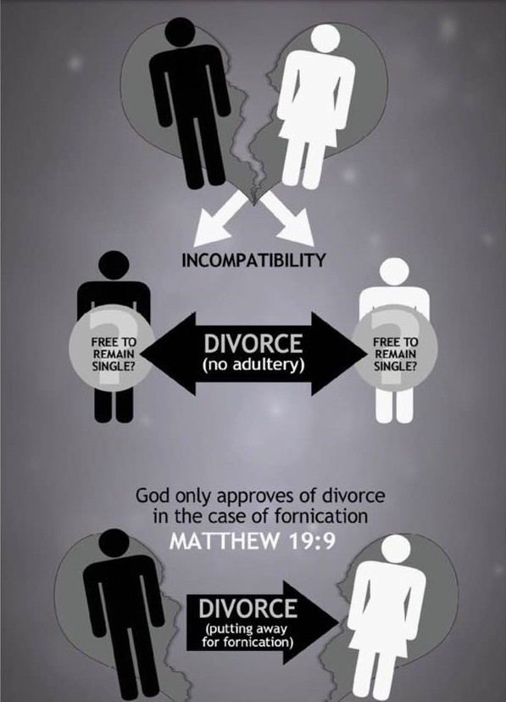

Slide 40
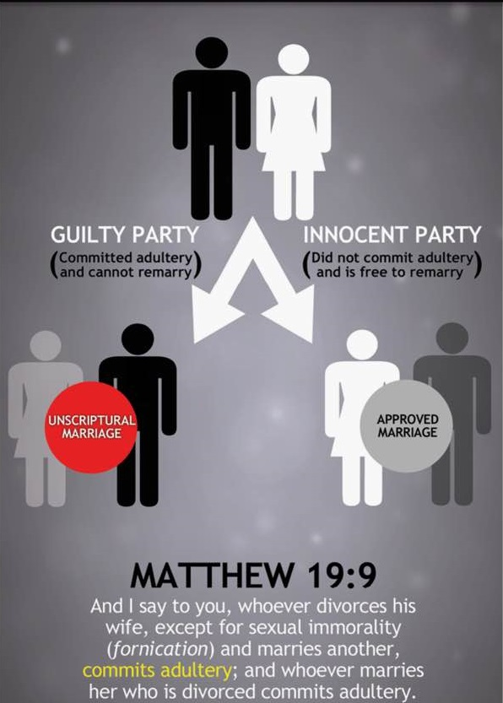

Slide 41
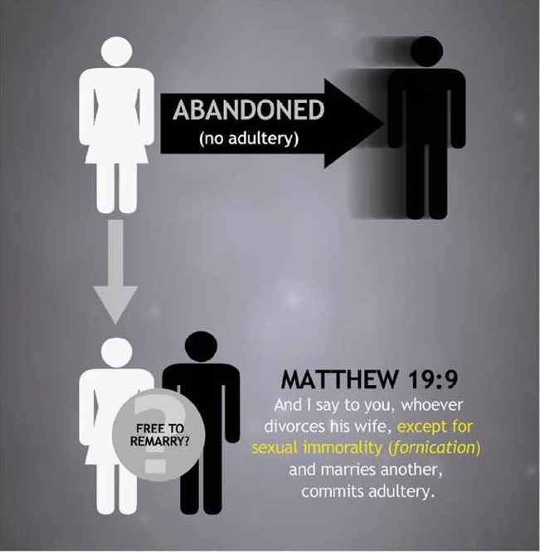

Slide 42
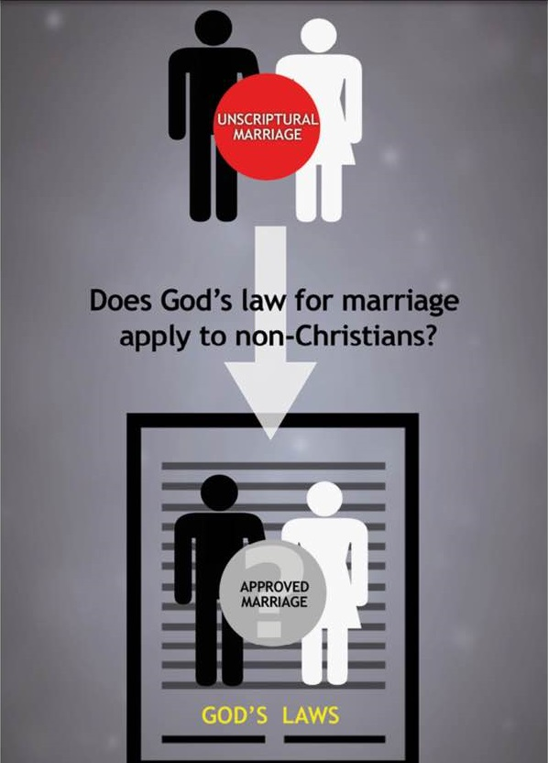

Slide 43
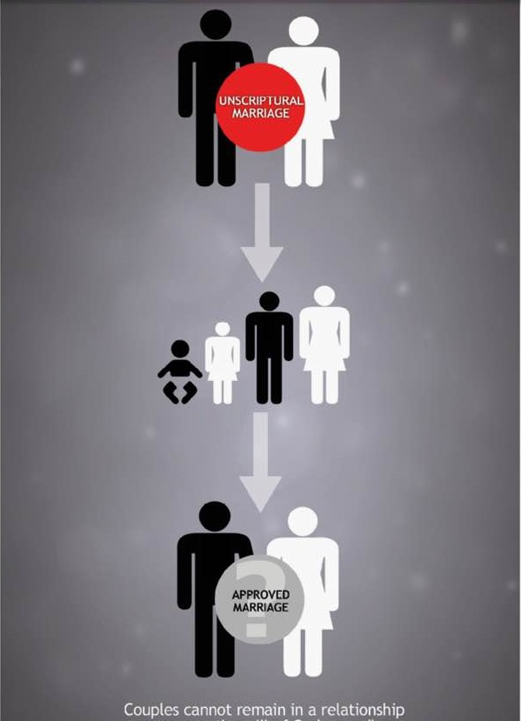

Slide 44
Both early Christians & moderns misunderstand difference & distinction between married & bond

Slide 45
“Not Under Bondage”
1 Corinthians 7:15
ARGUMENTS FOR FREEDOM TO REMARRY:
Paul legislates a new marriage law for mixed marriages.
Based on “not I but the Lord” (v.10) vs “I, not the Lord” (v.12).
Must be different from what Christ had previously taught.
“Not under bondage” must refer to marriage bond, therefore free to remarry.

Slide 46
“Not Under Bondage”
1 Corinthians 7:15
Paul is not legislating a new marriage law, but giving inspired application of Christ’s teaching to mixed marriages.
CHRIST’S MARRIAGE LAW:
“not to depart/divorce” (vv.10-11)
If divorced, still possible to serve the Lord.
“remain unmarried or be reconciled” (v.11)
PAUL’S APPLICATION:
“not divorce” (vv.12-13)
If divorced, still possible to serve the Lord.
Not “under bondage” but called to “peace” (v.15)

Slide 47
“Not Under Bondage”
1 Corinthians 7:15
“Not under bondage” does not refer to marriage bond.
Different word used:
deo (1Cor. 7:27, 39; Rm. 7:2) - marriage bond
douloo (1Cor. 7:15) - enslaved (never used of marriage bond)
Greek grammar would show is not referring to marriage bond
Perfect tense: action happened in past and continues in present. In this case, action has “not” happened in the past nor present.
Not in bondage now nor in past (not true of marriage bond).

Slide 48
“Not Under Bondage”
1 Corinthians 7:15
What is Paul saying?
A mixed marriage is a legitimate marriage and therefore the believer has a responsibility to preserve the marriage.
But a believer is “not under bondage” to preserve the marriage if it is beyond his/her ability to do so.
A believer’s responsibility to the marriage does not enslave them to an impossible task preserving the marriage when deserted. They are called to “peace”.
What is said about the right to remarry? Nothing.

Slide 49
Four Bible Positions on “Bound”
1. “Bound” and Scripturally Married – Matthew 19:5
2. “Bound” and Unmarried – I Cor. 7:10-11
3. One mate “Bound” while being unscripturally married to another – Mark 6:16-17; Romans 7:2-3
4. One mate “bound” though unmarried while the other mate is free – Matt. 19:9
Remember, “bound” means, “Obligation, namely to law” (Thayer, Page 131, # 2b)

Slide 50
Confusion Over Marriage & The Bond
Marriage
Bond
Same
Thing
Equate
the two
“If no longer married, then no longer bound”
Contrast marriage/divorce “in the eyes of God” –vs- “in the eyes of men”
Marriage / Divorce
(God Approves)
“In the eyes of God”
“Real”
Marriage / Divorce
(God Not Approves)
“In the eyes of man”
“Not Real”

Slide 51
“Married” Versus “Bound”
No more obligation?
Argument: When a marriage is ended by divorce, no bond or obligation remains. Thus anyone can remarry regardless of the cause of the breaking up of a former marriage.
And I say to you, whoever divorces his wife, except for sexual immorality, and marries another, commits adultery; and whoever marries her who is divorced commits adultery.”
— Matthew 19:9; NKJV
¹⁰ To the married I give this charge (not I, but the Lord): the wife should not separate from her husband ¹¹ (but if she does, she should remain unmarried or else be reconciled to her husband), and the husband should not divorce his wife.
— 1 Corinthians 7:10–11; ESV
Adultery: “unlawful sexual intercourse with someone other than one’s spouse”

Slide 52
“Married” Versus “Bound”
Defined by Paul
¹ Or do you not know, brethren (for I speak to those who know the law), that the law has dominion over a man as long as he lives? ² For the woman who has a husband is bound by the law to her husband as long as he lives. But if the husband dies, she is released from the law of her husband. ³ So then if, while her husband lives, she marries another man, she will be called an adulteress; but if her husband dies, she is free from that law, so that she is no adulteress, though she has married another man.
— Romans 7:1–3; NKJV
A woman is bound to her husband as long as he lives. Paul did not write “as long as they are married.”
If she marries another man while her husband still lives (and thus she is still bound to him), she will be called an adulteress.
She is married to the second man, but not bound with reference to him; she is still bound to the first man.
Even though she has sexual relations in her remarriage, it is adultery because she is not bound to the second man even though she is married to him.
Adultery: sexual relations between a bound person and someone to whom that person is not bound

Slide 53
Difference in Marriage and Bond
2 For the woman who has a husband is bound by the law to her husband as long as he lives. But if the husband dies, she is released from the law of her husband.
3 So then if, while her husband lives, she marries another man, she will be called an adulteress; but if her husband dies, she is free from that law, so that she is no adulteress, though she has married another man.
Bound to 1st Husband
Married to Another Man

Slide 54
Adultery Redefined
What is adultery?
Argument: Adultery has a non-sexual meaning in these passages and refers to the divorcing of one’s spouse and marrying another.
Argument: “Adultery” has multiple meanings in Scripture.
Idolatry (Jeremiah 3:9)
Sign seeking (Matthew 12:39)
Breaking wedlock (Ezekiel 16:38)
Friendship with the world (James 4:4)
Evil in general (Hosea 7:1)
Divorce and remarriage (Matthew 19:9)
But I say to you that everyone who divorces his wife, except on the ground of sexual immorality, makes her commit adultery, and whoever marries a divorced woman commits adultery.
— Matthew 5:32; ESV
=
How does this definition work with Matthew 5:32?
whoever divorces his wife,
and marries another,
commits adultery

Slide 55
What About The “R” Word – Repentance?
Can One “Live in Adultery”?
Whether “adultery” is used literally as is the case in Matt. 5:32; 19:9; Mark 10:11-12; and Luke 16:18 or in a figurative sense regarding Israel committing adultery with idols the concept always includes a third party.
Ray Summers comments, “The present tense indicates progressive action at the present time…” thus indicating that one can live in an adulterous relationship (Summers, 11).

Slide 56
Married To One & Bound To Another
2 For the woman which hath an husband is bound by
the law to [her] husband so long as he liveth; but if the
husband be dead, she is loosed from the law of [her]
husband. 3 So then if, while [her] husband liveth, she
be married to another man, she shall be called an
adulteress: but if her husband be dead, she is free from
that law; so that she is no adulteress, though she be
married to another man.
Not
Bound To
Married To
Bound
1st husband
Another Man

Slide 57
God’s Law:
Obligates and Restrains – Romans 7:2; 1 Cor.7:39
Bound By
Bound By
TO
TO
Married

Slide 58
The Marriage and the Bond
Marriage is a relationship enters into by agreement and by compliance with civil law
Bond – covenant with God that joins one to his mate (Matthew 19:6).

Slide 59
Basic or Foundational Principles
The Difference in the Marriage and the Bond
We Must Have Authority for All That We Do
The Bible Forbids the Put Away One from Remarrying

Slide 60
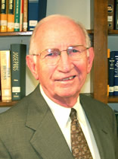
All Are Subject To Christ’s Law on MDR
“The current disposition of some to justify divorce for any reason if there is no remarriage causes me to stress that the sin Jesus speaks of here rests in divorce, not remarriage. Such a divorce is wrong on three counts. It is wrong because it shows no love for the mate. It is wrong because it could push the divorced mate into a damning relationship. And it is wrong because it could involve another otherwise innocent person in adultery…”

Slide 61
Moderns Misunderstanding covenant relationships protracts the process & manipulative end games

Slide 62
WHO HAS THE AUTHORITY TO MARRY?
Those who have never been married – 1 Cor.7:2, 27-28
Those whose mate has died - Romans 7:2-3
Those reconciling - 1 Cor.7:11
One who put away their mate for fornication - Matthew 19:9
THERE IS NO AUTHORITY FOR THE PUT AWAY FORNICATOR TO REMARRY

Slide 63
Matthew 19:9
And I say unto you, Whosoever shall put away his wife, except it be for fornication, and shall marry another, committeth adultery:
and whoso marrieth her which
is put away doth commit adultery.

Slide 64
The Issue Is NOT . . .
That an innocent mate has certain conditional rights granted by God.
A “race to the courthouse.”
About “counter suits.”
That we are binding some specific procedure in order to “put away” a spouse and scripturally remarry.
That man’s law supercedes God’s law.
What is written or specified on the court documents.
Reconciliation of a divorced couple.
What happens after the death of a spouse.
The definition of Greek words like “apoluo.”
Notes:
1
Let’s spend a minute discussing some things that are not at issue in this debate
We all agree that the law of Christ provides certain conditional rights to an innocent mate. We will be talking a good bit about those necessary conditions, but all agree there are rights stated for an innocent marriage partner
We will NOT be arguing about who has the fastest car or who can race the fastest to the courthouse. In fact, though bro. Reeves may try to wage an emotional argument along these lines, this actually has nothing at to do with what we are discussing
There has been a lot said and written about one marriage partner suing for divorce and the other making a countersuit. Again, this does not pertain to the case we are debating
We are sure that bro. Reeves will try to convince you that we are attempting to bind a certain specific civil procedure in order to put away a spouse and remarry. This is not true. There are as many ways to end a marriage are there are cultures and societies that regulate such activity. We are simply saying that once a marriage has been dissolved, by whatever means that happens, it is, in fact, dissolved and there are consequences that follow
We do NOT believe that man’s law supercedes God’s law, and we are not saying that man’s law can nullify God’s law
Neither are we maintaining that court documents contain specific wording, for instance specifying that fornication is the cause for the divorce. We believe, of course, that this must be the cause, but we do not argue that it must be so stated on court documents
When we mention that a put away person cannot remarry, we do not mean to include the possibility of a put away person being reconciled to their previous mate. We understand that 1 Cor. 7:10,11 teaches this as an authorized possibility. When we talk about remarrying, we mean to marry another, different person
We know that things change after one’s rightful marriage partner dies. This does not factor into the proposition we are defending
We are confident that bro. Reeves will entertain us with a long and thorough discussion of the Greek words, like “apoluo”, that are translated as divorce or put away in our English Bibles. I am not a Greek scholar, nor do I believe that one must be in order to understand the clear and simple teaching of the New Testament on marriage, divorce and remarriage. We will not be basing our proof on an appeal to the meaning of such Greek words

Slide 65
The Issue IS . . .
Is a divorce really a divorce?
Does God “recognize” a “putting away” which occurs for reasons other than fornication?
Is it possible for an innocent mate to be “put away in the eyes of God?”
Can fornication after a divorce be used as justification for a subsequent “mental divorce” and remarriage?
Is there any authority for a “second putting away?”
Does the Bible teach a necessary order which must be followed to allow scriptural remarriage?
Can “put away” mean different things depending upon circumstances?
Is the “waiting game” OK?
Notes:
2
Here’s what the issue is, this is what we are debating:
Is a divorce really a divorce? That is to say, does an action to dissolve a marriage really, and in all cases, bring that marriage to an end? I say yes. I think we’ll learn that bro. Reeves does not think so, not in all cases.
It is argued by some that God does not recognize a divorce that occurs for a cause other than fornication. We’ll show that He does recognize such divorces, and that real consequences follow such a divorce.
We are certain to hear that there are some divorces that are “in the eyes of men” but “not in the eyes of God”, or that God doesn’t recognize certain actions of putting away. I maintain that He does recognize when one puts away his mate, even when that is an unjust, unrighteous action.
This is a key element of this debate, and we’ll be emphasizing this again and again. We are debating a case where no fornication occurred before the marriage was dissolved. Bro. Reeves will argue that fornication AFTER a putting away can be the basis for a subsequent action, shall we say, a “mental divorce”, and then remarriage. We deny this.
No where in the Bible do we read of a second putting away. We will be watching for bro. Reeves to prove that such a thing is scriptural.
This debate, bottom line, is about following the biblical pattern – the scriptural order – for putting away and remarriage. In just a moment we will address this issue, but for now remember that ORDER DOES MATTER
Words mean things, and the same word in the same verse cannot at the same time mean two different things. Watch out for this as our discussion develops. We believe bro. Reeves will have to do some “double talking” to try to prove his point.
For many years gospel preachers have spoken out against what has been called “the waiting game.’ Bro Reeves is defending a sort of “waiting game.” The divorce happens, the marriage is dissolved, then WAIT and see – it might just be that one of two can remarry in the future if they wait long enough.

Slide 66
In every culture or society there is a recognized convention that designates a man and woman as being “married.”
When a man and woman are thus “married,” there are consequences which follow.
Similarly, there is a recognized method by which a marriage is terminated.
When a marriage has been ended, there are consequences which follow, including this one . . .
The remarriage of a “put away” person (to another while their bound mate lives) is specifically forbidden
Matthew 5:32 ". . . whosoever shall marry her that is divorced committeth adultery."
Matthew 19:9 ". . . and whoso marrieth her which is put away doth commit adultery."
Luke 16:18 ". . . whosoever marrieth her that is put away from her husband committeth adultery.”
Notes:
In every culture or society there is a recognized convention that designates a man and woman as being “married.” When a man and woman are thus “married,” there are consequences which follow.
Similarly, there is a recognized method by which a marriage is terminated. When a marriage has been ended, there are consequences which follow, including this one: The remarriage of a “put away” person (to another while their bound mate lives) is specifically forbidden.
The Scriptures are clear about this. Matthew 5:32 says, ". . . whosoever shall marry her that is divorced committeth adultery.“ Matthew 19:9 says, ". . . and whoso marrieth her which is put away doth commit adultery.“ Luke 16:18 says, ". . . whosoever marrieth her that is put away from her husband committeth adultery.”
God’s Word could not be clearer. When one who has been put away remarries another person (while their bound mate is still living), it is adultery.

Slide 67
Divorce IS Divorce "And unto the married I command, yet not I, but the Lord, Let not the wife depart from her husband: But and if she depart, let her remain unmarried, or be reconciled to her husband: and let not the husband put away his wife." (1 Corinthians 7:10-11)
Marriage IS Marriage
"For Herod himself had sent forth and laid hold upon John, and bound him in prison for Herodias' sake, his brother Philip's wife: for he had married her. For John had said unto Herod, It is not lawful for thee to have thy brother's wife." (Mark 6:17-18)

Slide 68
It IS Possible to ‘Put Away’ An Innocent Spouse
“Whosoever putteth away his wife, and marrieth another, committeth adultery: and whosoever marrieth her that is put away from her husband committeth adultery.” (Luke 16:18)
NOTE, in this situation:
The original wife was innocent of fornication.
We know this because the husband commits adultery when he remarries.
Yet “whosoever marrieth her that is put away from her husband committeth adultery.”

Slide 69
It IS Possible to ‘Put Away’ An Innocent Spouse
“But I say unto you, That whosoever shall put away his wife, (saving for the cause of fornication,) causeth her to commit adultery: and whosoever shall marry her that is divorced committeth adultery.” (Matthew 5:32)
NOTE, in this situation:
The original wife was innocent of fornication.
We know this because her husband “causeth her to commit adultery” – she was not guilty before this occurred.
Yet “whosoever shall marry her that is divorced committeth adultery.”

Slide 70
It IS Possible to ‘Put Away’ An Innocent Spouse
“And I say unto you, Whosoever shall put away his wife, (except it be for fornication,) and shall marry another, committeth adultery: and whoso marrieth her which is put away doth commit adultery.” (Matthew 19:9)
NOTE, in this situation:
The original wife was innocent of fornication.
We know this because her husband commits adultery when he remarries.
Yet, “whoso marrieth her which is put away doth commit adultery.”

Slide 71
Matt. 19:9 – Two
Independent Clauses
And I say unto you, Whosoever shall put away his wife, except it be for fornication, and shall marry another, committeth adultery:
A
B
and whoso marrieth her which
is put away doth commit adultery.

Slide 72
Matt. 19:9
And I say unto you, Whosoever shall put away his wife, except it be for fornication, and shall marry another, committeth adultery:
A
B
and whoso marrieth her which
is put away doth commit adultery.

Slide 73
Matt. 19:9
Put Away (for forn.) - Remarry - No Adultery
Put Away (no forn.) - Remarry - Adultery
A
B
Is Put Away - Remarry - Adultery

Slide 74
The Exception Phrase Cannot Modify the Second Phrase
“In Matthew 19:9 the original Greek text translated ‘except for fornication’ modifies the ‘putting away’ on the part of the man and does not modify the person who is put away.” Leonard Latkovski, Professor of Classic Languages, Bellarmine College

Slide 75
The Exception Phrase Cannot Modify the Second Phrase
“In my opinion, the phrase ‘except it be for fornication.’ applies to the first clause but not to the second” Dr. Harry Sturz, Greek Department, Biola College

Slide 76
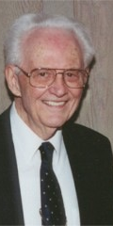
Hugo McCord
“They know that in no Greek manuscript does the exceptive phrase appear in the second clause, and that without its being there, their cause is lost. Therefore they say the phrase must be inferred in the second clause.” - Spiritual Sword Lectureship, 1979

Slide 77
“Actually, however, the omission of the definite Greek article from the second clause forbids grammatically (besides the contradiction) carrying over the exceptive phrase to the second clause. This is true because the second clause in omitting the definite article cannot refer to any specific woman, but to any put-away woman. A marriage with any put-away woman, Jesus asserted, is adultery. To make Jesus say that he was only eliminating non-adulterous wives from remarriage, not adulterous ones, is slander against the beauty of the Lord's teaching.
The AV and the ASV both are faithful to the text in omitting the article from the second clause. The RSV and the NASV are clear, setting forth precisely what the Lord said... But the NEB ("a woman thus divorced") and the NIV ("a woman so divorced") bring the exceptive phrase of the first clause into the second, and so do not faithfully translate Jesus' words.” Spiritual Swords Lectureship, 1979

Slide 78
We Must Have Authority for All That We Do
Colossians 3:17
2 John 9
Silence does not establish authority - Silence is prohibitive not permissive - Hebrews 7:14
Authority is Established by: (Acts 15)
Direct Command
Approved Example
Necessary Inference or Conclusion

Slide 79
Authenticity of Matthew 19:9b
Some translations do not contain Part B of Matthew 19:9
NASB- “And I say to you, whoever divorces his wife, except for immorality, and marries another woman commits adultery.”
ESV – “And I say to you: whoever divorces his wife, except for sexual immorality, and marries another, commits adultery.”
It is Found in the Majority of Manuscripts
Bruce Metzger was asked by Donnie Rader - “Is there any textual evidence to reject the phrase ‘and whoso marrieth her which is put away doth commit adultery’?” - His answer was "No”
Pulpit commentary - “It has very high authority in its favor”

Slide 80
Authenticity of Matthew 19:9b
Even If It Could Be Proven That Matthew 19:9b was not part of the original text – There is no doubt as to the authenticity of the statement
Matthew 5:32
Luke 16:18

Slide 81
Unscriptural Divorce
Leaves One Unmarried
10 ¶ Now to the married I command, yet not I but the Lord: A wife is not to depart from her husband.
11 But even if she does depart, let her remain unmarried or be reconciled to her husband. And a husband is not to divorce his wife.
Unscript. Divorce Remain UNmarried
NOT
Unscript. Divorce Remain Married

Slide 82
Olan Hicks
“This establishes, if we take precisely what the scriptures say, omitting human opinion entirely, that the 'adultery' which is to be repented of in this case, consists of two actions, 'putting away' and 'marrying another'

Slide 83
Who Has The Right To Remarry?
The man who puts away his wife NOT for fornication
The man who puts away his wife FOR fornication
The woman who is put away FOR fornication
The woman who is put away NOT for fornication
Whosoever shall put away his wife,except it be for fornication,and shall marry another, committeth adultery:
and whoso marrieth her which is put away doth commit adultery.
(Matthew 19:9)
Notes:
Our debate is about who has the right to remarry, so let’s see what the Bible says.
Let’s study Matthew 19:9
The first part of this verse deals with the man who puts away his wife.
If he puts away his wife, but NOT for fornication, he cannot remarry without commiting adultery
But, if he puts away his wife FOR fornication, then he is authorized by God to remarry without sin
The second part of the verse addresses the situation with the woman who has been put away.
If she was put away FOR fornication, bro. Reeves and I would agree that she cannot remarry
However, notice that there is no exception is this second part of the verse. Even the woman who was innocent when she was put away cannot remarry without committing adultery.
We are debating about the right of a put away woman to remarry, and Matthew 19:9 says that no put away woman man remarry. It is just that simple.

Slide 84
“But someone asks: ‘What about a woman who is put away (divorced) by a man simply because the man no longer wanted to be married? Fornication is not involved and the woman repeatedly tried to prevent the divorce, but to no avail. After a couple of years the man marries another woman. Is the ‘put away’ woman then free to marry? She certainly is, if she puts away her husband for fornication. She would have to do this before God in purpose of heart since the divorce has already taken place, legally speaking. She could not go through the process of having a legal document charging her husband with ‘adultery,’ but God would know . . .”
(Weldon Warnock, Searching The Scriptures, 11/85)
Notes:
I am here to deny the position advocated by Weldon Warnock when he wrote:
“But someone asks: ‘What about a woman who is put away (divorced) by a man simply because the man no longer wanted to be married? Fornication is not involved and the woman repeatedly tried to prevent the divorce, but to no avail. After a couple of years the man marries another woman. Is the ‘put away’ woman then free to marry? She certainly is, if she puts away her husband for fornication. She would have to do this before God in purpose of heart since the divorce has already taken place, legally speaking. She could not go through the process of having a legal document charging her husband with ‘adultery,’ but God would know . . .” (Searching The Scriptures, 11/85).

Slide 85
“The Scriptures teach that the innocent person (free of fornication) who has been put away without God's or his/her approval and against whom adultery has been committed may remarry . . . Of course, the woman of my proposition must wait until fornication is committed against her before remarriage . . . Whether the fornication is committed before or after the putting away by human authority is immaterial.”
(Marshall Patton, Patton/Phillips Debate, Searching The Scriptures, Feb., Mar., Apr.,/87)

Slide 86
“. . . if (the husband) commits adultery (before or after his action in the courts of man) . . . (the wife) may put away, reject, or divorce him as a moral and spiritual act.”
Ron Halbrook, (email correspondence)

Slide 87
If there is a “2nd Putting Away” . . .
Since the Bible is silent on this,
what would be the necessary conditions?
what terms must be met?
what qualifications would apply?
what would be the means of accomplishing it?
what method would one follow to do it?
how would one verify that this had taken place?
Can one answer these questions, while “speaking where the Bible speaks?”
In reality, for each lawfully bound couple there is one, and only one, putting away
Notes:
As we have been describing, there are those, including bro. Reeves, who are suggesting that there can be some sort of second putting away.
For instance, in regards to our proposition, the man puts away his wife for a cause other than fornication, then he LATER commits fornication. Bro. Reeves and others hold that the original wife can then engage in some sort of second putting away – perhaps something she only does in her own mind (thus “mentally divorce” the original husband) – and then she can remarry without sin.
The Bible is ABSOLUTELY silent about any such 2nd putting away. Since it is silent, we wonder
-what would be the necessary conditions of a 2nd putting away?
-what terms must be met?
-what qualifications would apply?
-what would be the means of accomplishing it?
-what method would one follow to do it?
-how would one verify that this 2nd putting away had taken place?
When and if bro. Reeves cares to answer these questions, will he be speaking where the Bible speaks? You know that the answer is NO! The Bible is SILENT on this. And, we know that silence does NOT provide authority to act.
In reality, for each lawfully bound couple, there is one and only one putting away.

Slide 88
Order IS Important!
Believe
Believe
The Bible
Be baptized
Baptists
Saved
Saved
Be baptized
Notes:
Let’s spend a few moments discussing ORDER. The proper order of things is very important. In fact, if we do not follow the proper order, things get completely confused.
For instance, let’s consider the proper order of the plan of salvation. The Bible teaches that one must believe, be baptized and then he is saved. Mark 16:16 reads: "He that believeth and is baptized shall be saved . . .”
There are those, however, who want to change this God given order in the plan of salvation. They say that when one believes, he is saved, and then he should or could be baptized later. This is what the Baptists teach, and faithful brethren have always taught that this is wrong because the order is wrong.

Slide 89
Let’s Look at the Biblical Order Regarding Divorce & Remarriage
Fornication
Putting Away
“Mental Divorce”
Fornication
The Bible
Putting Away
Remarriage
Remarriage
Notes:
Now, let’s look at the biblical order regarding divorce and remarriage. The Scriptures teach that when fornication is committed by one of the marriage partners, the innocent party may put away the guilty for this cause, and then the innocent party may remarry without sin. This is what we read in Matthew 5:32 and 19:9
The “mental divorce” controversy which is causing much unfortunate division in the body of Christ today, has resulted from some who are teaching that there can be a putting away - the dissolution of the marriage - NOT for the cause of fornication, then LATER if fornication occurs, there can be a remarriage.
This is WRONG – because the order is wrong! Just like the Baptists are wrong on the order of the plan of salvation, those who are advocating “mental divorce” are wrong because they have the ORDER wrong!

Slide 90
The Waiting Game
Marshall Patton described “the waiting game” as a situation “where husband and wife mutually agree to divorce with a view to waiting until the other commits fornication thinking that he/she is then free to remarry. The mutual agreement makes each an active participant in the putting away.”
He said he would NOT defend those who do this
However, in defining and explaining his proposition he said: “The Scriptures teach that the innocent person (free of fornication) who has been put away without God's or his/her approval and against whom adultery has been committed may remarry . . . Of course, the woman of my proposition must wait until fornication is committed against her before remarriage . . . Whether the fornication is committed before or after the putting away by human authority is immaterial.”

Slide 91
Mental Divorce & “The Waiting Game”

Slide 92
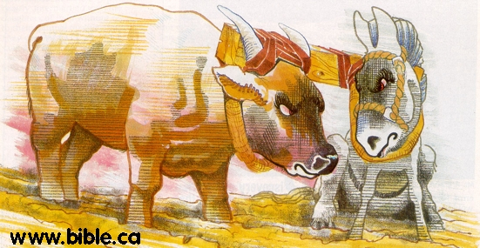
UNEQUALLY YOKED OR
Equally NOT Yoked!

Slide 93
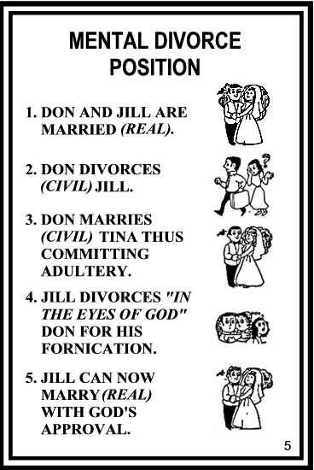

Slide 94
Divorce & Remarriage: What Does The Text Say? Mental Divorce (May Some Put Away People Remarry?) I. The Position Stated “This position states that some put away people can remarry (e.g. one put away for some cause other than fornication whose mate remarries first). In application it says that when Jack puts away Jill (for being a poor cook) that, though that is a civil divorce, they are not really divorced. It is called a divorce only ‘accommodatively.’ If Jack then remarries another woman, he, being guilty of adultery can be put away mentally by Jill. This is the ‘real’ divorce” (pg. 74, emp. jhb).

Slide 95
“MENTAL DIVORCE” The Second Putting Away/The Waiting Game THE PRINCIPAL ARBITRARY RULES 1.) The “put away” (divorced person) must have done everything possible to keep the first marriage intact. 2.) They must also have resisted being “put away” (divorced). 3.) The person who did the putting away must later commit fornication, for the one who was put away to be able to then “put away” their ex-mate and remarry. The reason for these arbitrary rules is the NEED to invalidate the first divorce, since both sides agree that no remarriage is authorized by God AFTER divorce. Remember Gal. 1:8-9; I Pet. 4:11; II Jn. 9

Slide 96
A MARRIAGE IS A MARRIAGE Rom. 7:2-3, “For the woman which hath an husband is bound by the law to her husband so long as he liveth; but if the husband be dead, she is loosed from the law of her husband. 3 So then if, while her husband liveth, she be married to another man, she shall be called an adulteress: but if her husband be dead, she is free from that law; so that she is no adulteress, though she be married to another man.” Word Games: “Married/Divorced only in the Eyes of Men” versus “Married/Divorced in the Eyes of God.” Cp. w. I Cor. 7:10-11, “And unto the married I command, yet not I, but the Lord, Let not the wife depart from her husband: 11 But and if she depart, let her remain unmarried or be reconciled to her husband: and let not the husband put away his wife.”

Slide 97
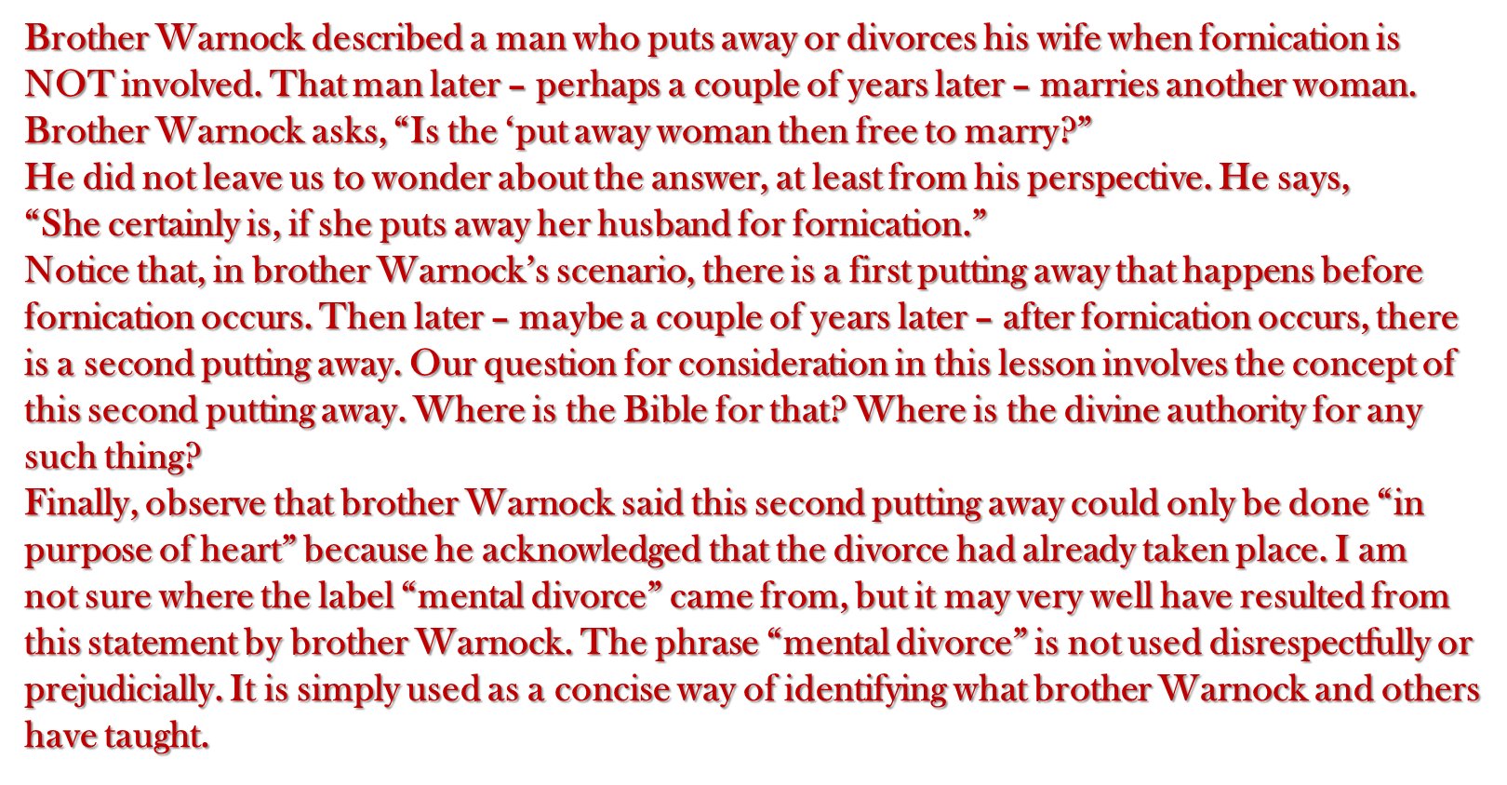
MENTAL DIVORCE & “THE WAITING GAME”

Slide 98
MENTAL DIVORCE & “THE WAITING GAME”
Man’s ability to justify his sins is amazing. "God hath made man upright; but they have sought out many inventions" (Eccl. 7:29). In their efforts to justify divorces and remarriages of every description, men have come up with the following concept. When two people cannot get along and they decide to break up their home in the absence of adultery, it is a sinful tragedy, but the result is that they are both free to marry new partners . Some people would add that after such a divorce, both parties are free to marry new partners only after one of them commits fornication . (After already having repudiated their marriage, and waiting for one or the other to fall into immorality, by some mental gymnastics one party puts away the other a second time!)
Still other folks argue that after such a divorce, when one party finally commits fornication, the other party alone is free to marry someone else. (This too requires the mental gymnastics of a person putting away a second time for another cause the mate whom they have already put away!) According to some of these inventions of men, if the first party enters an adulterous marriage after the separation, his bed of adultery can be transformed into the bed of honorable marriage by the hocus-pocus and mental gymnastics of his original mate.
How long is he guilty? Until his first mate says, "I don’t want to be bound to that adulterous partner." That is when that man stops committing adultery (Glen Lovelady in [J.T.] Smith-Lovelady Debate on Marriage, Divorce, & Remarriage [Brooks, KY: Searching the Scriptures, 1976], p. 69).
The mere words of his first mate sanctify the adulterous marriage.
Such cases, scenarios, and variations might be multiplied endlessly, but they all share the common fallacy of "the waiting game." They all share the concept that all remarriages, regardless of the circumstances, can be justified by waiting . A person can put a stumbling block before his mate, wait for her to fall over it, then proclaim himself free to enter another marriage. He could do this again and again, just so he tries to "do better" each time. Or, a person in an adulterous marriage can wait for his mate to say some words which free him from the adultery while allowing him to stay in the very same marriage. Such a theory would allow him to move from one marriage to another again and again if he could get the last mate to say the magic words after each new remarriage.

Slide 99
MENTAL DIVORCE & “THE WAITING GAME”
The Teaching of Jesus in Matthew 5:32
Jesus prohibited and precluded every possible variation of "the waiting game" in divorce and remarriage.
It hath been said, Whosoever shall put away his wife, let him give her a writing of divorcement:But I say unto you, That whosoever shall put away his wife, saving for the cause of fornication, causeth her to commit adultery: and whosoever shall marry her that is divorced committeth adultery (Matt. 5:31-32).
Let us notice briefly what the Law of Moses said and how men misuse it. Then, we will examine more closely what Jesus said.
During the Mosaic Age, when God tolerated polygamy, He also tolerated divorce for a cause short of fornication: uncleanness or shameful indecency (Deut. 24:1-4). The severe limitations and restrictions placed upon such a divorce discouraged it, but it was permitted temporarily "because of the hardness of your hearts" (Matt. 19:8). Some very liberal minded Jews perverted Deuteronomy 24 to justify divorce for any and every cause, and some like-minded brethren today misuse the passage in the same way. Jack Freeman claims, "God was allowing…divorce if she burned the toast or the biscuits….He did under the Law that He gave through Moses" (Marriage Series, No. 1, North Las Vegas Church of Christ, Las Vegas, NV, 1988). Maurice Estes claims, "Divorce for any cause under the Law of Moses dissolved the marriage," even for such flimsy excuses as a wife going about "with her hair undone," and this established "the right of both parties to remarry" (Marriage, Divorce & Remarriage: The Scriptures Speak [Morro Bay, CA: Meco Foundation, Inc., 1979], pp. 5-8).
That is the kind of foolishness Deuteronomy 24 was designed to eliminate. This misuse of the Law of Moses is utilized today by some brethren to twist Matthew 5:32 to justify freeing both parties for second marriages no matter what the cause of the divorce. Some brethren profess that both parties are free to marry new mates only if the divorce was caused by fornication, but they end up allowing people to stay in adulterous marriages formed after divorces which were not for fornication. Maurice Estes perverts both the Law of Moses and the Law of Christ to argue that "there must be today the same understanding of the effect of a scriptural writing of divorcement: that it frees both parties to remarry" (ibid. , p. 6). All such arguments lend themselves to "the waiting game" fallacy. It does not matter how or why the marriage breaks up, regardless of how flimsy the excuse , as soon as either party remarries, the other is considered free to remarry. The bottom line is this: All cases of remarriage following divorce for any and every cause can be justified with the help of "the waiting game," some mental gymnastics, and a little hocus-pocus.

Slide 100
MENTAL DIVORCE & “THE WAITING GAME”
A Rule, One Exception, No Waiting Game
The Law of Christ embodies a rule with one exception. The rule is, "Whosoever shall put away his wife causeth her to commit adultery: and whosoever shall marry her that is divorced committeth adultery." The man who divorces his wife for any and every cause will be responsible for her subsequent adulterous marriage. This man will be held accountable to God for causing his wife to fall into sin. That does not exonerate her from guilt in forming and maintaining an adulterous union. In the case presented by Jesus, a subsequent marriage is assumed as is evident from his reference to the one who marries "her that is divorced." The subsequent marriage is clearly held to be immoral, adulterous, or impure in God’s sight, contrary to the claim that God recognizes or approves every marriage which is legal according to human law (Hebrews 13:4). The rule announced by Jesus forever prohibits and precludes people breaking up their marriage and waiting for their mate to commit adultery, as a pretext for claiming the right to select a new marriage partner!
The exception has the following force. "Whosoever shall put away his wife FOR FORNICATION is not responsible for her subsequent adultery: and whosever shall marry her that is divorced committeth adultery." Again, Jesus assumes the case of a second or subsequent marriage and condemns it as adulterous, but the man who divorced her because of her immorality is not the cause of the sin she commits when she remarries. The claim that she is living in adultery in the subsequent marriage until her original mate says he releases her is ludicrous, the vain imagination and wicked invention of men attempting to create loopholes in divine law. Waiting for her former mate to say hocus-pocus will not resolve her adultery. If that would suffice, John could have easily resolved the incestuous adultery of Herod and Herodias by getting Philip to say he did not want her back anyway. John told Herod in no uncertain terms, "It is not lawful for thee to have her" (Matthew 14:4).
J.W. McGarvey summed it up well in his excellent commentary on The Fourfold Gospel (p. 242):
Jesus here limits the right of divorce to cases of unchastity, and if there be a divorce on any other ground, neither the man nor the woman can marry again without committing adultery….and in no part of the New Testament is there any relaxation as to the law here set forth…and it is therefore held almost universally…that the innocent party to such a divorce can marry again. Of course the guilty party could not, for no one is allowed by law to reap the benefits of his own wrong.
God’s law on marriage is one man for one woman for life, with only one exception. The exception is that an innocent partner can put away an immoral mate, and marry another person without committing adultery. No theory of man, including "the waiting game," can nullify or alter one iota of God’s law. – Guardian of Truth Magazine

Slide 101
QUESTIONABLE POSITION
The Lord said:
Second “Put Away” adds:
WITHOUT CAUSE
PUT
AWAY
FORNICATION
“PUT
AWAY”
THEN MAY
UNMARRIED
UNBOUND
Matthew 19:9
?

Slide 102
Matthew 19:9
Jesus Said:
Fornication
Innocent may
Put Away Guilty
Innocent May Remarry
Waiting Game:
Put Away
Then Fornication is committed
Put Away
(Repudiate)
(Rejects)

Slide 103
“WHENEVER”
ABSOLUTE
The Lord addressed the married
Consequences of adding: “whenever”
BEFORE
MET
ENGAGED
MARRIED
SINGLE
P A
U W
T A
Y
P A
U W
T A
Y
FORNICATION
FORNICATION
FORNICATION
FORNICATION
UNMARRIED
UNBOUND
?
Matthew 19:9
FORNICATION

Slide 104
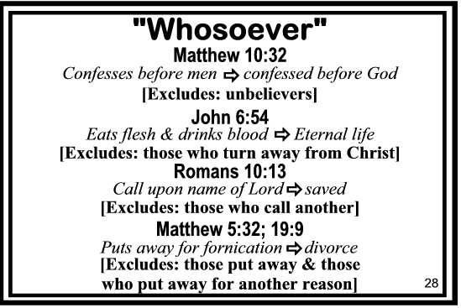

Slide 105
“It is my conviction that there are only three classes of people who have a right to marry: (1) those who have never been married: (2) those whose companions are dead; and (3) those who have put away a companion for the cause of fornication. It appears to me that any attempt to find authority for anyone else to marry, must trade on the silence of the scriptures. I realize that brother Warnock's illustration involves fornication but is after the fact of divorce and not before. It is very difficult for me to see how this is not in reality the ‘waiting game’ for one waits until the other sins and then claims scriptural cause. I am also made to wonder if we may have the ‘mental divorce’ then why not at the other end of the marriage have a ‘mental marriage’ before the fact of social and legal requirements being met. Indeed, is this not the very thing claimed by those who insist that two people may cohabit as long as they have a ‘meaningful relationship’ and plan to get married anyhow?” (emp. jhb). Connie W. Adams (Searching the Scriptures, February issue, 1986). (See brother Adams’ full editorial in the complete Warnock-Deason Exchange posted on this website.)

Slide 106
The Rebuttal Premise
“The scriptures allow for situations where one might have to divorce his mate in order to live for Christ.”
“If one must leave his marriage in order to be faithful to Christ, he has the God-given right and obligation to do so.”
“The basic law is that one is not to leave his spouse whether he is married to a believer or unbeliever. However, the exception to that basic law is that God comes before a wife or husband just like any other relationship. Any departure must be ‘for the kingdom of God’s sake.’”

Slide 107
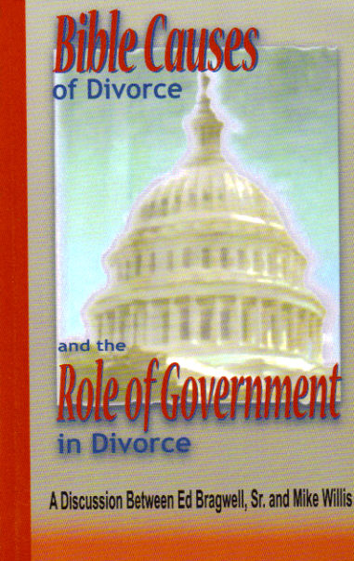
The Latest On Causes For Divorce
“The Scriptures allow for situations where one might have to divorce his mate in order to live for Christ.” Mike Willis
Bible Causes of Divorce and the Role of Government in Divorce (p. 21)

Slide 108
Advertised On The Front Page Of http://www.truthmagazine.com
“A person may divorce his mate for the cause of Christ. If one must leave his marriage in order to be faithful to Christ, he has the God-given right and obligation to do so.” Mike Willis
Bible Causes of Divorce and the Role of Government in Divorce (p. 23)

Slide 109
The Latest On Causes For Divorce
“Given the fact that one may have to leave his wife and children in order to serve the Lord, the Bible does not teach, ‘The only cause for divorce is fornication.’ Mike Willis Bible Causes of Divorce and the Role of Government in Divorce (p. 27)
A Fact Is Verifiable, Yet What Brother Willis Asserts As “Fact” Is Verified Only By Himself.
Cp. w. Rom. 8:35-39

Slide 110
The Latest On Causes For Divorce
“Given the fact that one may have to leave his wife and children in order to serve the Lord, the Bible does not teach, ‘The only cause for divorce is fornication.’ That simply is not a true statement. There are other causes for divorce, including the cause mentioned in the Matthew 10:34-38; Luke 14:26; 18:29-30; I Corinthians 7:12-13—in order to live as a Christian. What is a more accurate statement of what the Bible teaches is this: There is only one cause for divorce which gives the innocent party the right of remarriage (Matt. 19:9).” Mike Willis Bible Causes of Divorce and the Role of Government in Divorce (p. 27)

Slide 111
IN MY INFORMED OPINION…
NEITHER PARTY IS INNOCENT &
NEITHER IS CANDIDATE FOR RE-MARRIAGE
In concluding, I wish to make an observation of personal opinion. First, I believe our study has proven that couple’s players of this elongated “waiting out” endgame of Mental Divorce are guilty of robbing scripture of its obvious literal meaning or in the least wrestling God’s Holy Word of its implied intention. Secondly, both parties participating in such shady mind-games of mental divorce – by striving to “wait-out” the other in order to “win-out” in the eyes of men – instead are pursuing mutually assured destruction in God’s Eyes and will have to answer dearly for it on judgment day. – D. L. Burris

